Slide 1
Test Driven Development(tdd)
Presenter : Mufassir shah ☺
Hold on To Your Seat Belts

Slide 2
What Are We Gonna Cover
What Is TDD?
Pros and Cons OF TDD
Demo
Questions Answers Session

Slide 3
Before We Get Started
No Perquisites, I’ll try to explain things to the best of my abilities
Any kind of constructive criticism is warmly welcomed
All the content will on this repo
https://github.com/MufassirShaw/presentation

Slide 4
What ON Earth Is TDD???
Is It A Testing Technique? OR Is It Yet Another Tool/Library/Framework To Mess Up Our Mind?

Slide 5
Mukuraiye !!!! :p
It Is Neither A Testing Technique Nor A Freaking Library/Framework/Tool.

Slide 6
So What Is It???

Slide 7
In a Nutshell
From Kent Beck’s XP it Is A Software Development Methodology To Build Software Products.
But In A Fun Way
Just Like Playing COD4 hannn?:P
Notes:
One of the 17 devs of the agile manifesto

Slide 8
Well, Not Exactly ☹ But It Is Still Fun Enough
Failing Test(s) for a feature is written prior to its implementation.
The developer is supposed to pass that test in order to unlock that feature. Just like you do in games.
Of-course unlocking means building that feature.
Notes:
When you write one test, you concentrate on one thing. With many tests you spread your attention on many tasks, so it's not a good idea.

Slide 9
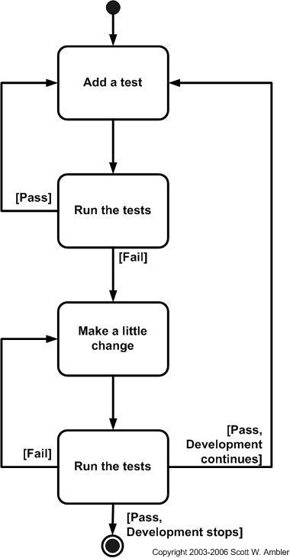
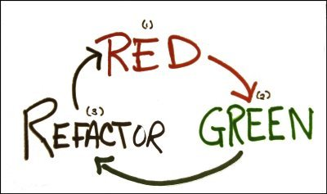

Slide 10
And That’s IT Forks
Told You It Is Easy

Slide 11
But Why TDD??
It reduces defect rates. 1]Williams et al and Maximillien and Williams present the findings of a case study of industrial programmers at IBM. They notice a significant defect rate reduction in the new project using TDD; approximately 50 % when compared to the third release and 40% when compared to the seventh release of an old project

Slide 12
Why TDD??
Increase code quality (decoupled and cohesive code).
2]Bhat and Nagappan present the results of two industrial case studies conducted at Microsoft. They compared the impacts of TDD and non-TDD development processes on quality and overall development time. Their results show that the quality of the code developed using TDD increased 2.6–4.2 times when compared to non-TDD developed code

Slide 13
Why TDD??
Test can serve as auto documentation for maintenance.
Proved by the study of Bhat and Nagappan.

Slide 14
Trade Off’s OF Using TDD
Overall project time may increase which will make project leads go crazy
Bhat and Nagappan study showed the project time grew by 15%-35% when using TDD.
Developer’s productivity may suffer.
3]Williams and George (2004) showed that the TDD developers took 16% more time the devs using other methodologies.

Slide 15
Demo

Slide 16
Questions

Slide 17
References
1] & 2] from Siniaalto, M., & Abrahamsson, P. (2007). A comparative case study on the impact of test-driven development on program design and test coverage
3] from Using Test Driven Development To Improve Software Development Practices By Raquellta Ros Aguilar

Slide 18
Thank You

